Slide 1
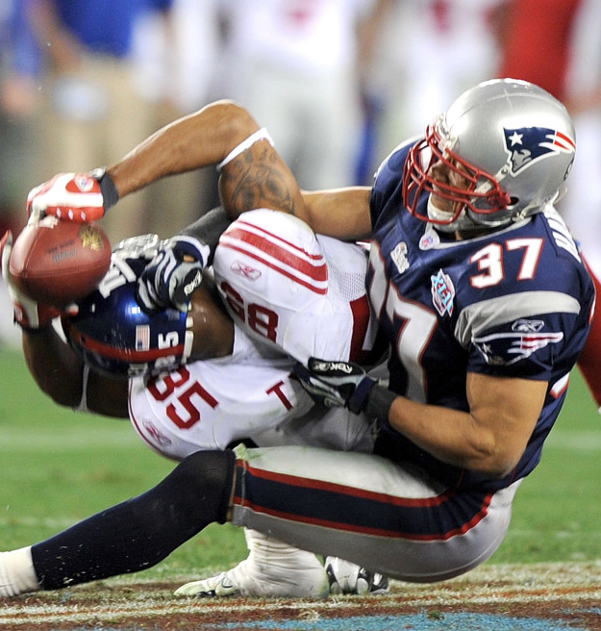
Analysis of Draft Value & Predictors of Success in the NFL Draft​
David Barer, Karam Chadha, Bradley Feingerts, Patrick Holbrook, Chris Payne, Fernando Serrano

Slide 2
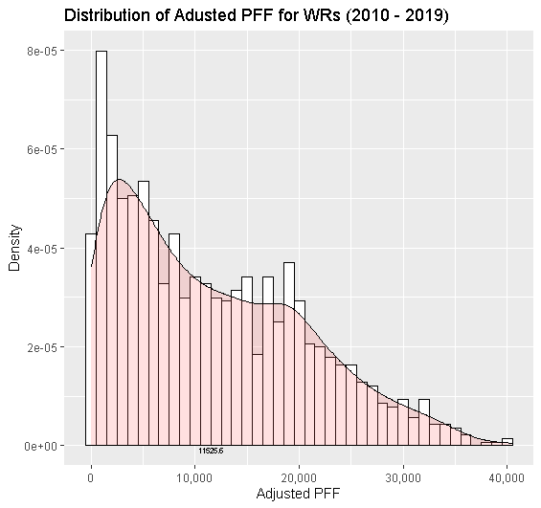
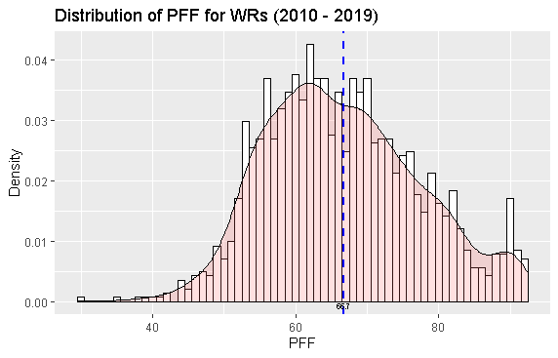
PFF is normally distributed, thus can reveal disparity in talent

Slide 3
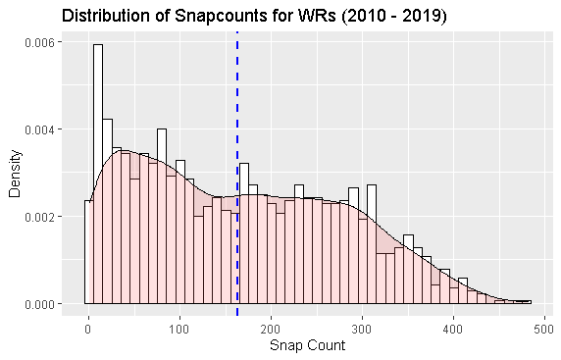
Remove Snap counts below 10?

Slide 4
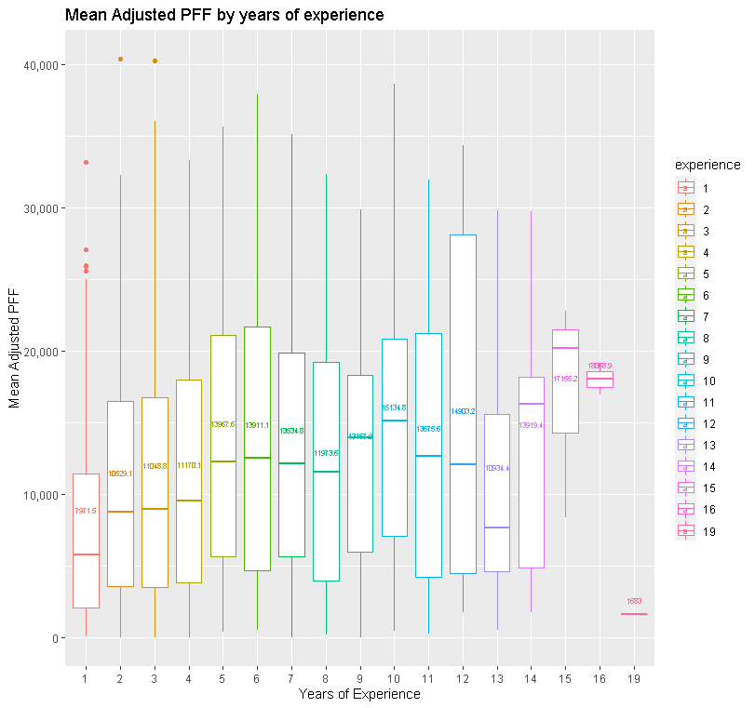
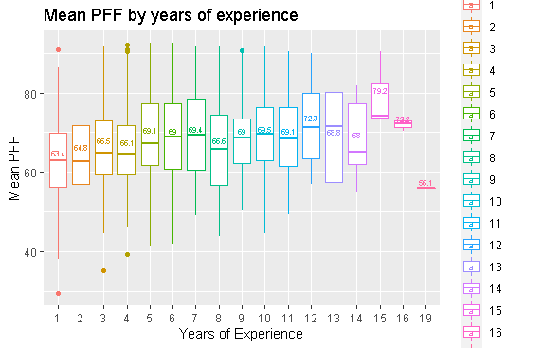
PFF increases by experience, indicating only better players survive

Slide 5
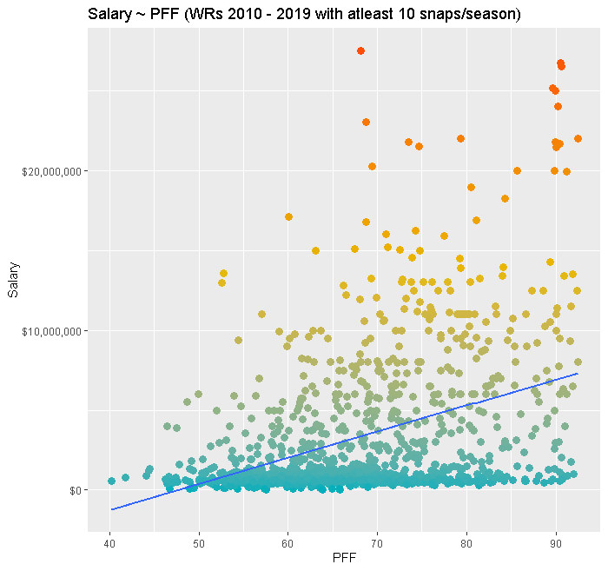
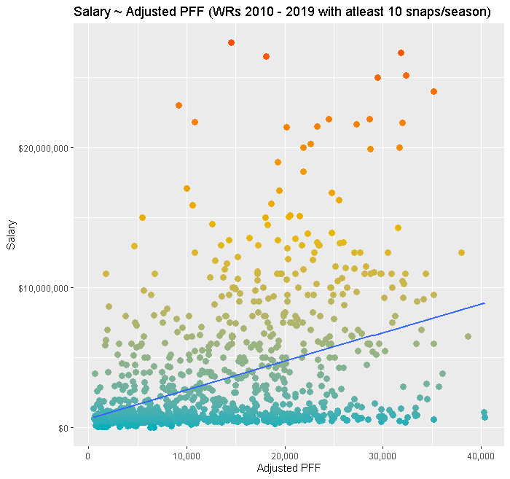
PFF is correlated positively with Salary

Slide 6
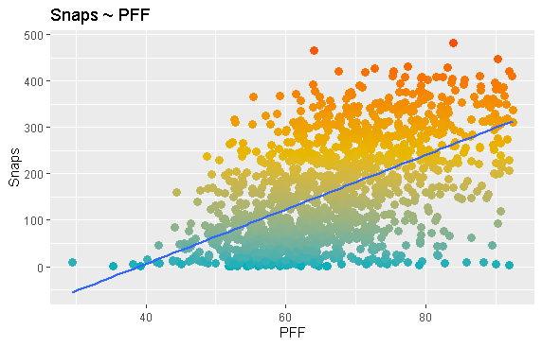
PFF is correlated positively with Snaps

Slide 7
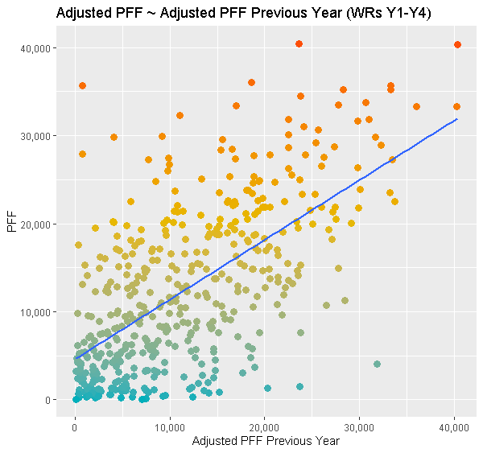
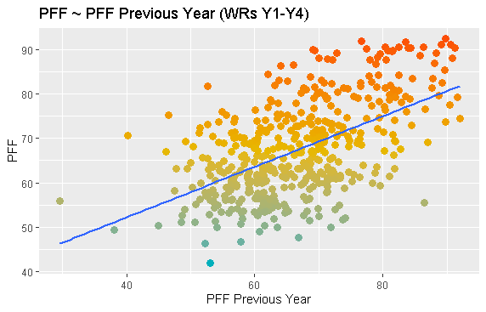
PFF can predict future PFF

Slide 8
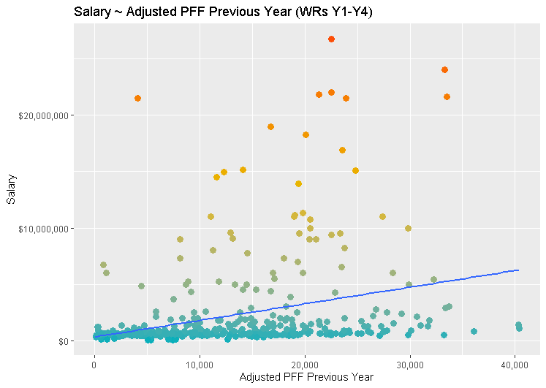
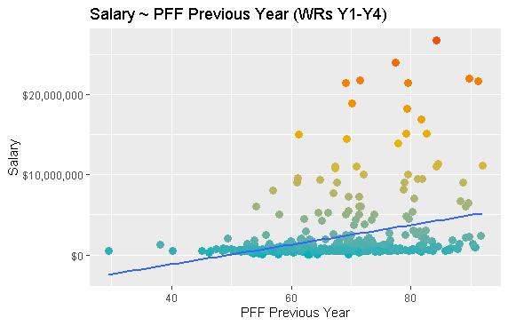
PFF can predict future Salary

Slide 9
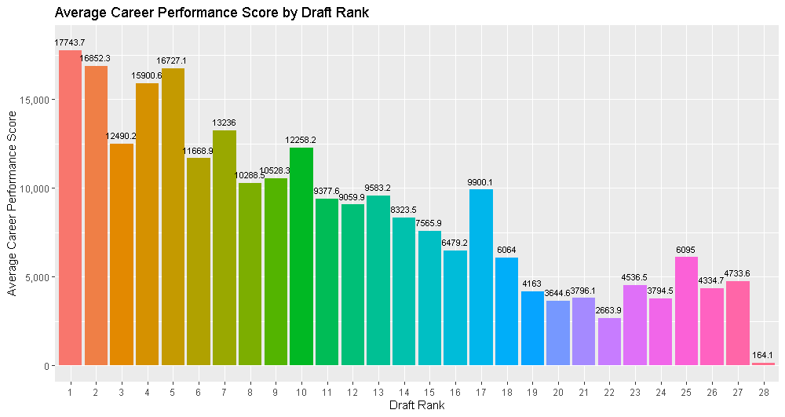
TBD: Career Performance Score by Draft Rank

Slide 10
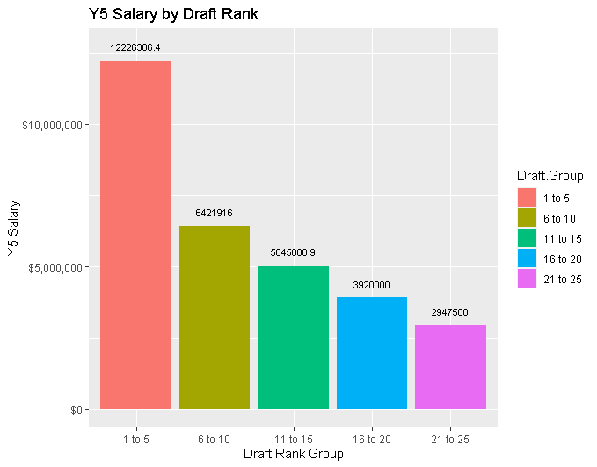
GMs know what they are doing?

Slide 11
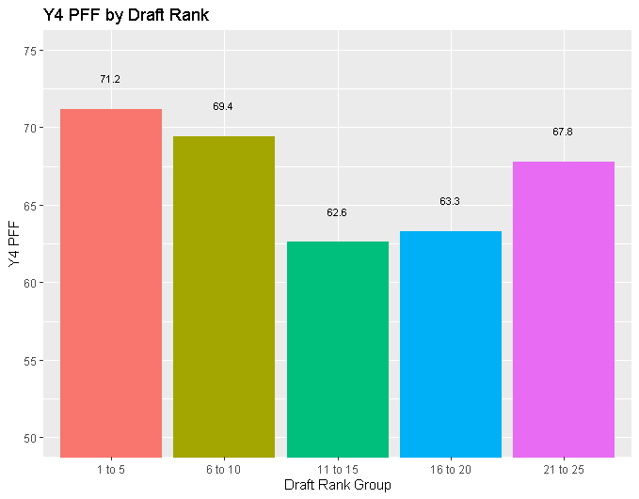
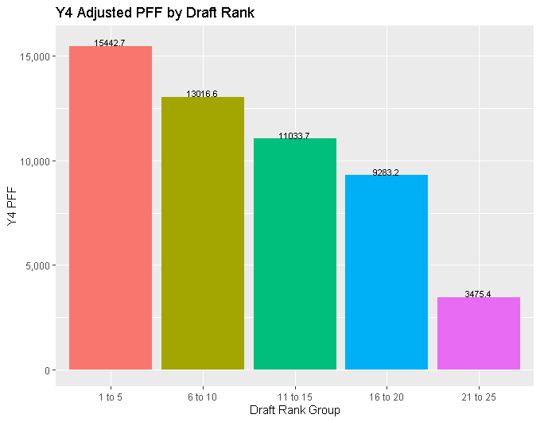
PFF by Draft Rank

Slide 12
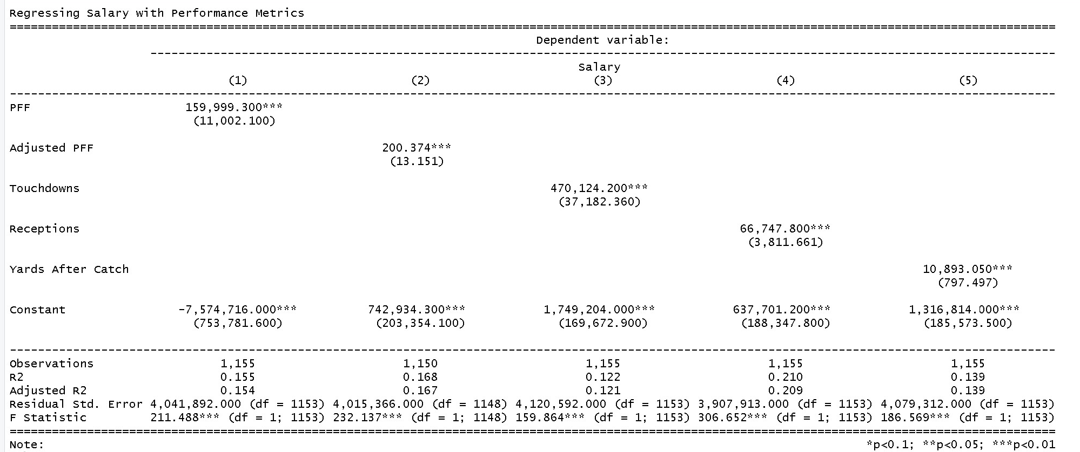
Regressing Salary Within Season PFF and Performance

Slide 13
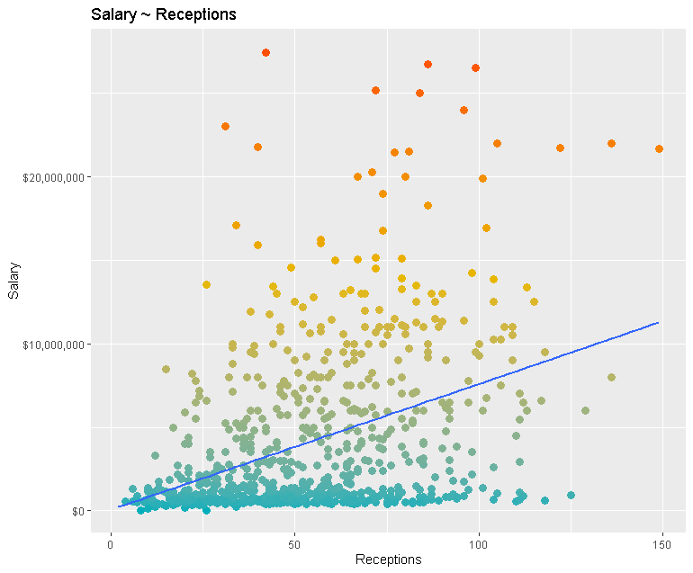
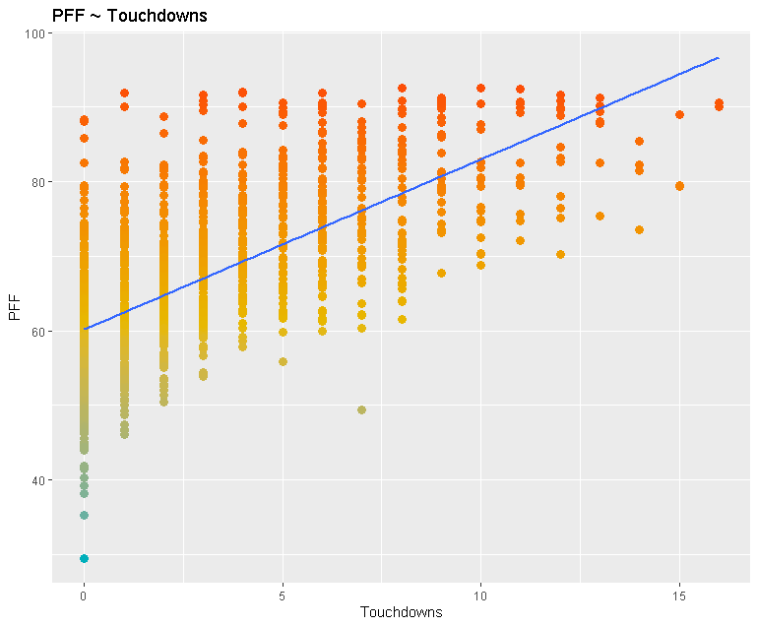
Other Scatter Plots

Slide 14
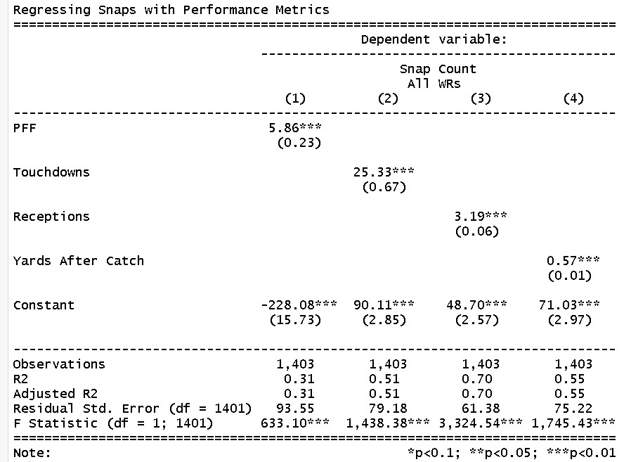
PFF does not correlate with snaps as well as receptions other usage metrics do (opportunity)

Slide 15
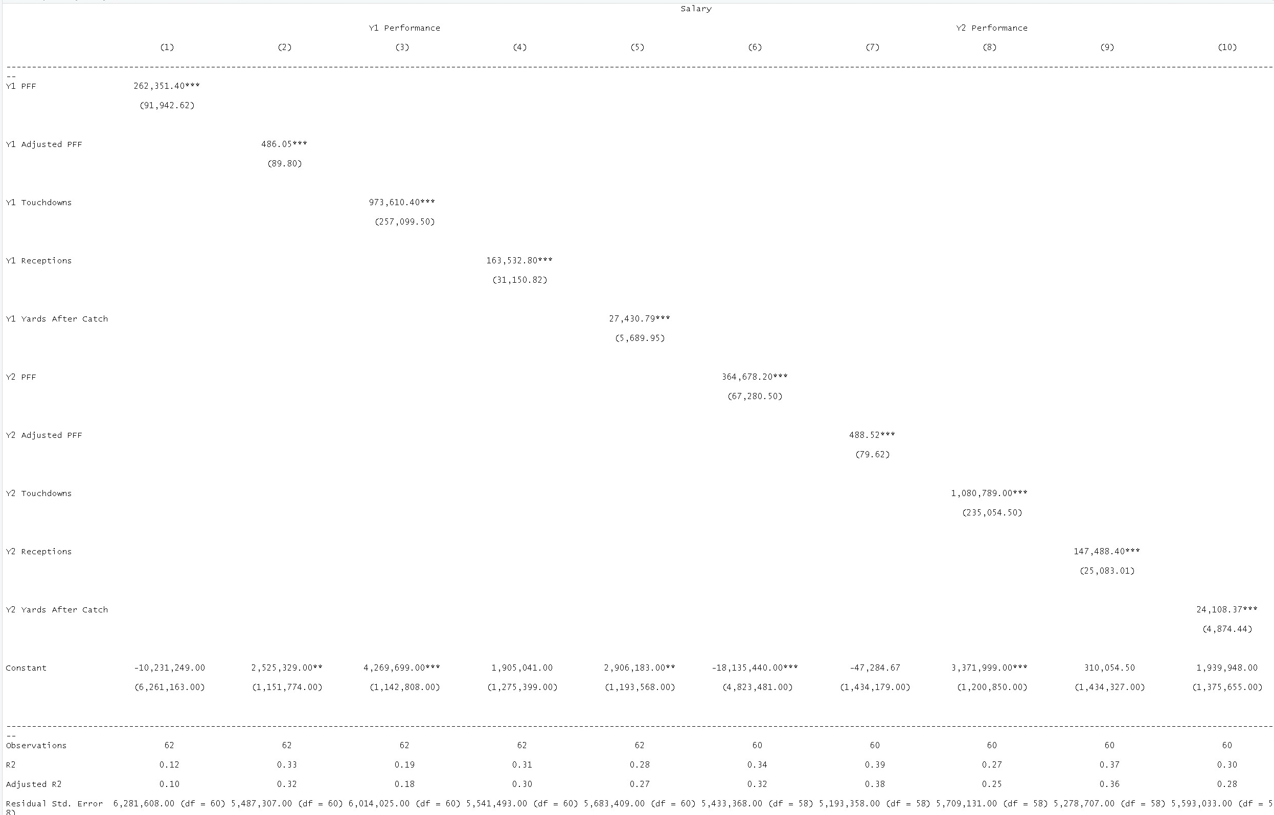
Receptions is a better predictor in year 1, implying usage is important for rookies

Slide 16
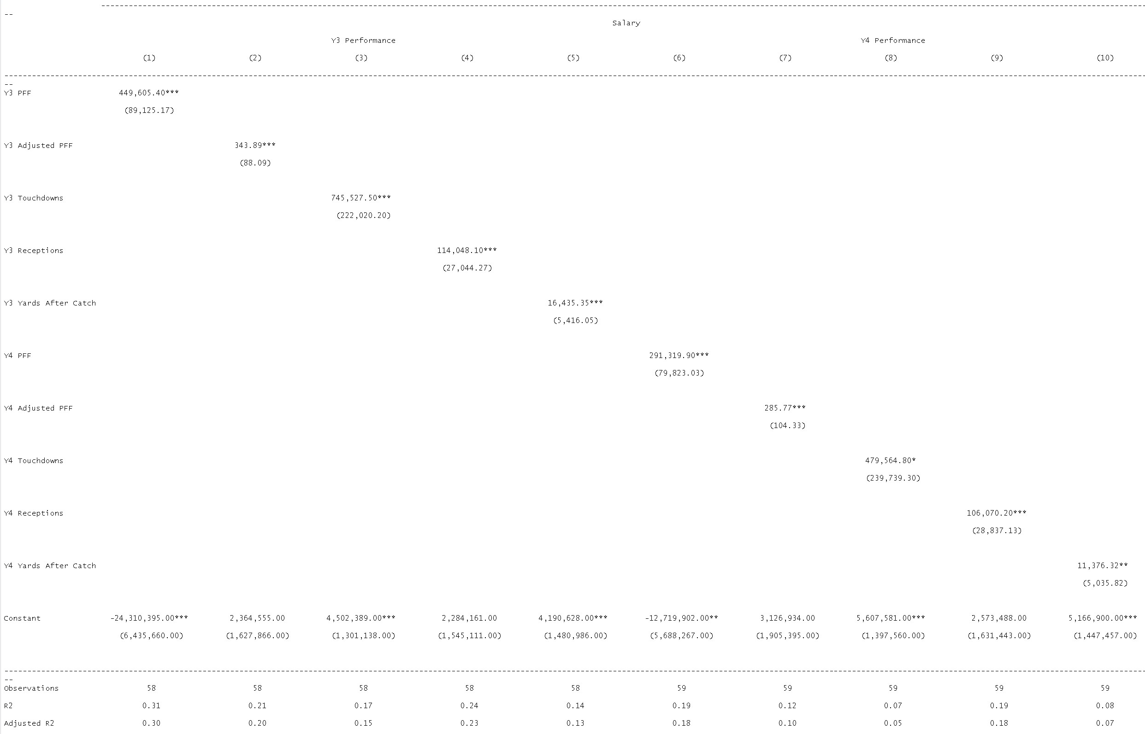
However by Y3 PFF is better at predicting Y5 Comp

